Slide 1
Introduction to Operators

Slide 2
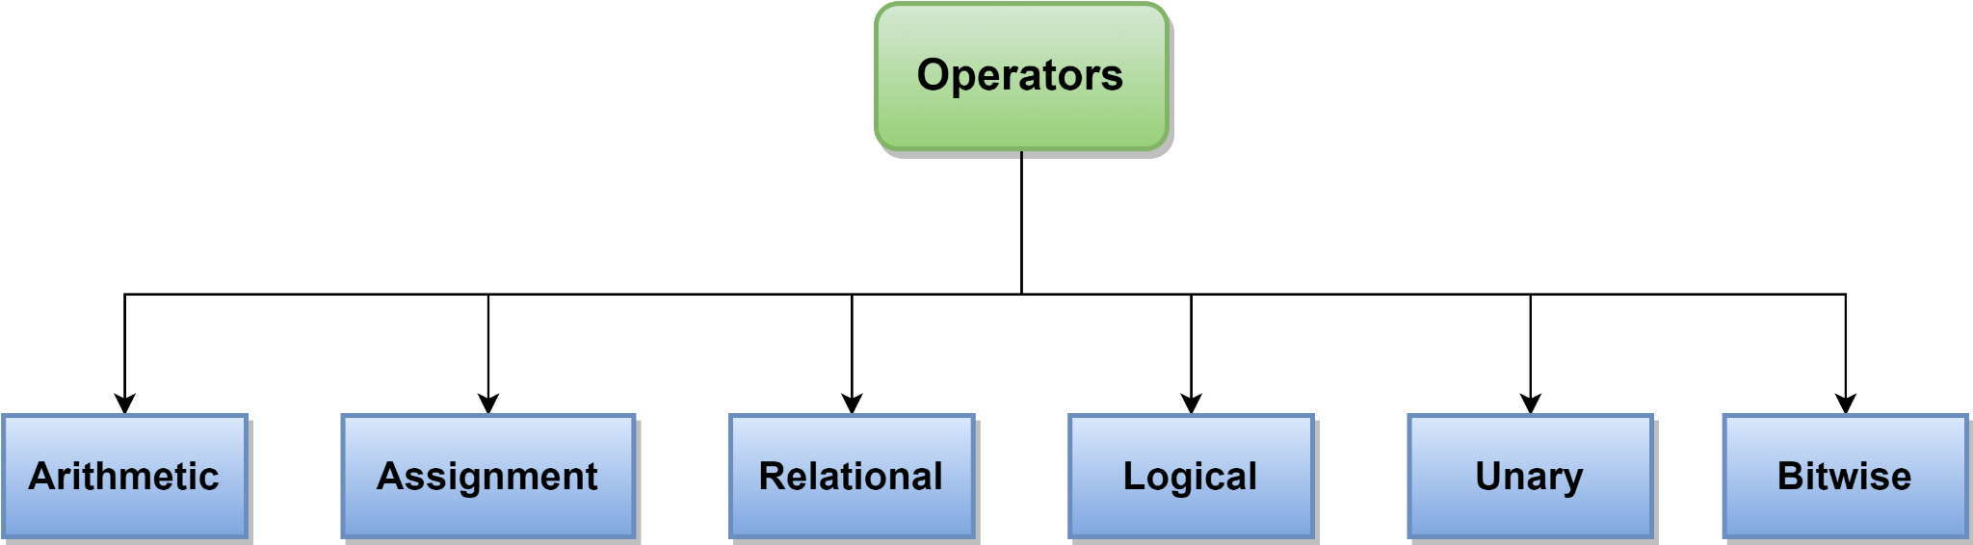
Operators
Operators are symbols used to perform specific operations on one or more operands to produce a result.
Types of operators in Java:

Slide 3
Arithmetic Operators
Category | Name | Symbol
Additive | Addition | +
 | Subtraction | -
Multiplicative | Multiplication | *
 | Division | /
 | Modulus | %

Slide 4
Arithmetic Operators (Continued)
Addition: Adds two variables/numbers of same datatype
Example:
Subtraction: Subtracts the second number from the first one
Example:
Multiplication: Multiplies the first operand with the second one
Example:
System.out.println(2+3); //Output: 5
System.out.println(7-3); //Output: 4
System.out.println(3*3); //Output: 9

Slide 5
Arithmetic Operators (Continued)
Division: Divides the first operand with the second one
Example:
Modulus: Finds the remainder after dividing the first number with the second
Example:
System.out.println(9/2); //Output: 4 System.out.println(9.0/2.0); //Output: 4.5
System.out.println(5%2); //Output: 1 System.out.println(7%9); //Output: 7

Slide 6
Assignment Operators
Name | Symbol | Identicality
Assignment | = | a = 5;
Addition Equals | += | a += 3; a = a+3;
Subtraction Equals | -= | a -= 3; a = a-3;
Multiplication Equals | *= | a *= 2; a = a*2;
Division Equals | /= | a /= 2; a = a/2;
Modulus Equals | %= | a %= 2; a = a%2;

Slide 7
Assignment Operators (Continued)
(=): Assigns the value on the right to the variable on the left.
Example:
(+=): Adds both the operands on its right and left and assigns the addition to the operand on its left .
Example:
int number = 10; float value = 2.5f;
int a = 5, b = 10; b += a; b = b+a; System.out.println(b); // Output: 15

Slide 8
Assignment Operators (Continued)
(-=): Subtracts the right operand from the left operand and assigns the result to the left operand.
Example:
(*=): Multiplies both the operands and assigns the result to the left operand.
Example:
int a = 5, b = 10; b -= a; System.out.println(b); // Output: 5
int a = 5, b = 10; b *= a; System.out.println(b); // Output: 50

Slide 9
Assignment Operators (Continued)
(/=): Divides the operand on its left with the operand on its right and assigns the result to the left operand
Example:
(%=): Divides the left operand by the right operand and assigns the remainder to the operand on the left.
Example:
int a = 5, b = 10; b /= a; System.out.println(b); // Output: 2
int a = 5, b = 10; b %= a; b = b%a; System.out.println(b); // Output: 0

Slide 10
Relational Operators
Category | Name | Symbol
Comparison | Greater Than | >
 | Less Than | <
 | Greater Than or Equals | >=
 | Less Than or Equals | <=
Equality | Equals | ==
 | Not Equals | !=

Slide 11
Relational Operators (Continued)
(>): Checks if the left operand is greater than the right operand.
Example:
(<): Checks if the left operand is less than the right operand.
Example:
(>=): Checks if the left operand is greater than or equals to the right operand.
Example:
System.out.println(5>3); // Output: true
System.out.println(5<3); // Output: false
System.out.println(7>=10); // Output: false

Slide 12
Relational Operators (Continued)
(<=): Checks if the left operand is less than or equals to the right operand.
Example:
(==): Checks if both the operands are equal.
Example:
(!=): Checks if the left operand is not equals to the right operand.
Example:
System.out.println(2<=3); // Output: true
System.out.println(5==3); // Output: false
System.out.println(7!=10); // Output: true

Slide 13
Logical Operators
Name | Symbol
Logical AND | &&
Logical OR | ||
Logical NOT | !
X | Y | AND Gate Output
0 | 0 | 0
0 | 1 | 0
1 | 0 | 0
1 | 1 | 1

Slide 14
Logical Operators
Name | Symbol
Logical AND | &&
Logical OR | ||
Logical NOT | !
X | Y | OR Gate Output
0 | 0 | 0
0 | 1 | 1
1 | 0 | 1
1 | 1 | 1

Slide 15
Logical Operators
Name | Symbol
Logical AND | &&
Logical OR | ||
Logical NOT | !
Input | Not Gate Output
0 | 1
1 | 0

Slide 16
Logical Operators (Continued)
(&&): Denotes true if both the conditions before and after are true, otherwise false.
Example:
(||): Denotes true if at least one conditions before and after are true, otherwise false.
Example:
(!): Reverses the logical value of the operand on its right.
Example:
int a = 5, b = 10, c = 20; System.out.println(a>b && b<c); // Output: false
System.out.println(5<-1 || 10>5); // Output: true
System.out.println(!(5>3)); // Output: false

Slide 17
Unary Operators
Type | Name | Symbol
Prefix | Negation | -
 | Not | !
 | Increment | ++
 | Decrement | --
Postfix | Increment | ++
 | Decrement | --

Slide 18
Unary Operators (Continued)
Negation (-): Negates an operand
Example:
Not (!): Reverses the logical value of an operand
Example:
int a = 5; int b = -a; System.out.println(b); // Output: -5
System.out.println(! false); // Output: true

Slide 19
Unary Operators (Continued)
Pre-Increment (++): Increments the operand by 1 and then assigned.
Example:
Pre-Decrement (--): Decrements the operand by 1 and then assigned.
Example:
int a = 5; int y = ++a; System.out.println(a); // Output: 6 System.out.println(y); // Output: 6
int a = 5; int y = --a; System.out.println(a); // Output: 4 System.out.println(y); // Output: 4

Slide 20
Unary Operators (Continued)
Post-Increment (++): The value is assigned first and then increments the operand by 1.
Example:
Post-Decrement (--): The value is assigned first and then decrements the operand by 1.
Example:
int a = 5; int y = a++; System.out.println(y); // Output: 5 System.out.println(a); // Output: 6
int a = 5; int y = a--; System.out.println(y); // Output: 5 System.out.println(a); // Output: 4

Slide 21
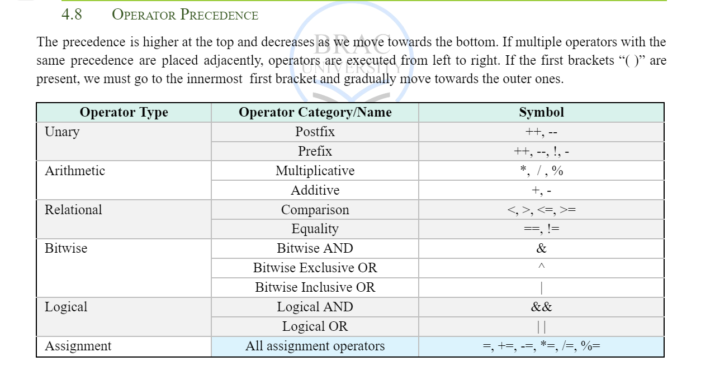

Slide 22
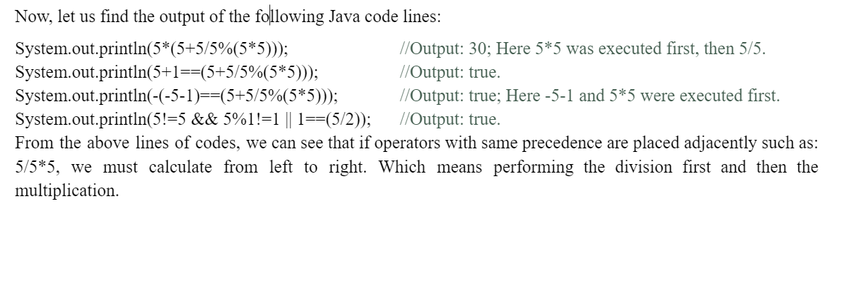

Slide 23
THANK YOU!

